Slide 1
Comparison of the coasts of Australia
BME 450A: Final Project
Michael Teng

Slide 2
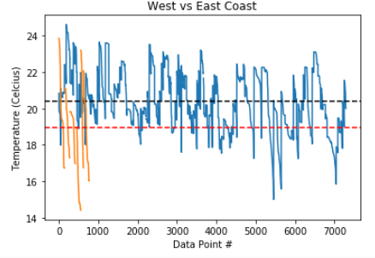
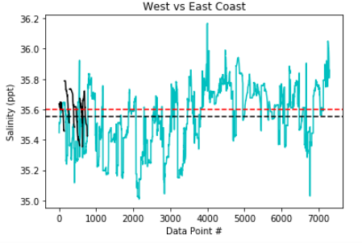
Temperature and salinity comparison from the East and West coasts of Australia
Coast | West Coast | East Coast
Temperature (°C) | 20.39 | 18.94
Salinity (ppt) | 35.56 | 35.6
Latitude | -33.99 | -32.0
Longitude | 151.45 | 115.4
https://portal.aodn.org.au/search

Slide 3
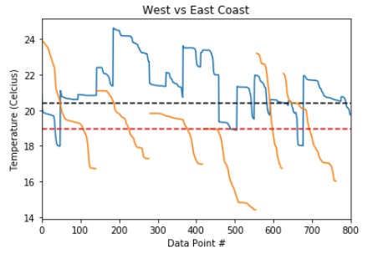
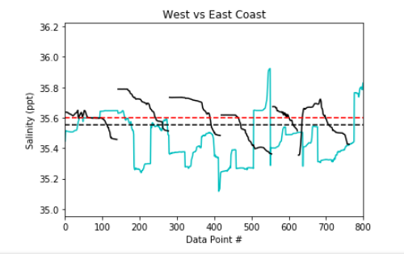
Conclusions
The data suggests that there isn’t much of a similarity for this small selection of data. There is a small pattern where the high peak values on one coast has an opposite low peak on the other coast.
https://github.com/miket0/Ocean-Data-Comparison

